Slide 1
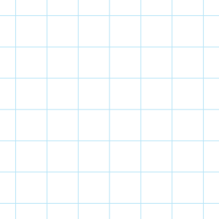



lvl zero
Code Organizing
Time Complexity
session #3
prepared by : Nabil Salah
ICPC
MANSOURA

Slide 2

Who Am i?
1
Vice Technical at ICPC Mansoura
2
ACPC Finalist 2023
3
CS lvl 200
4
Vice Backend at Cat Reloaded

Slide 3

lv zero
TODAY'S AGENDA
1
Functios
2
Structs
3
Time Complexity
Summary and Action Items

Slide 4

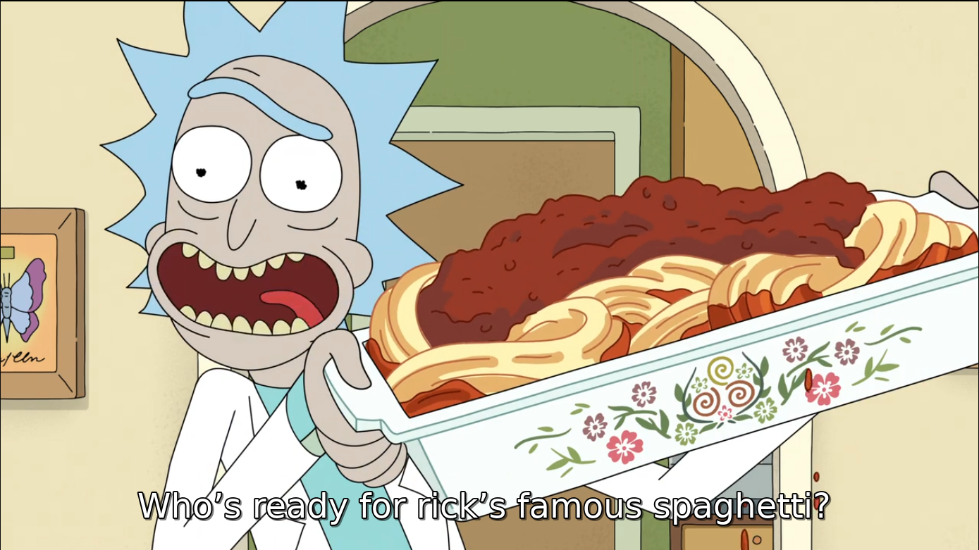
WHY WE NEED ORGANIZED CODE
IN
COMPETITIVE PROGRAMMING

Slide 5
lv zero
1
Easy Code Tracing
2
Easily Find bugs
3
Easily CO-OP with teammate

Slide 6


.
Given a String and array x of size n with distinct characters
Print how many times the character X[I] appears in the string?
EASY CHALLANGE

Slide 7


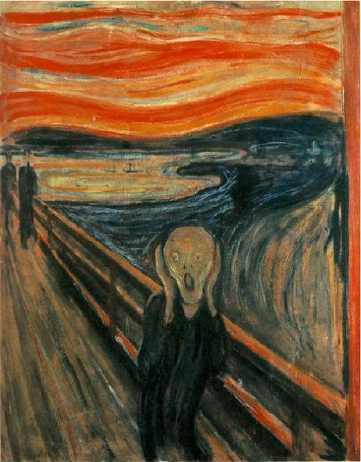

solution

Slide 8
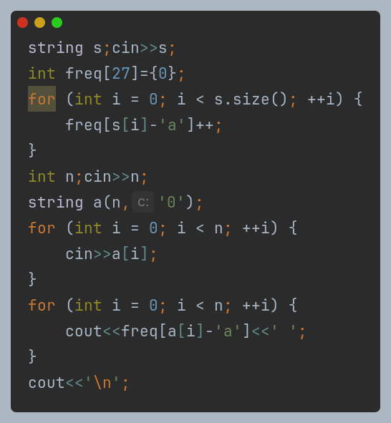

Slide 9
Return type
lv zero
int chartoindex(string s,int idx){
int ans = (s[idx]-'a');
return ans;
}
Parameters
Prototype

Slide 10
Look our for:
lv zero
Precedence
parameters type
Return type

Slide 11
lv zero
Another way of structuring code is.... Struct

Slide 12

Why do we use bags in supermarkets?
lv zero

Slide 13
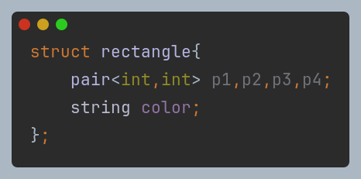
Struct name
lv zero
Member variables

Slide 14
coding time

Slide 15

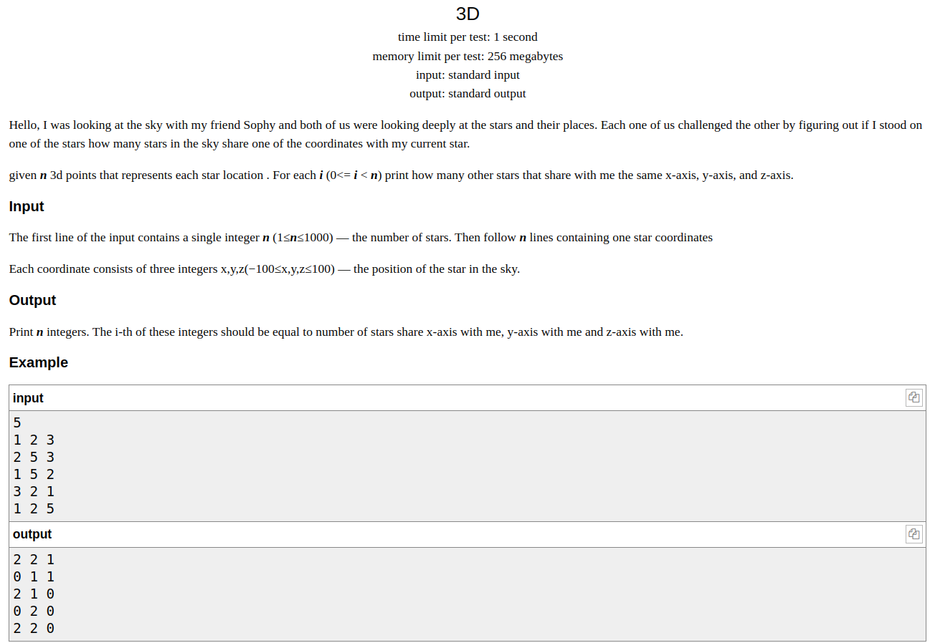
Statement
PROBLEM
LINK

Slide 16
solution

Slide 17
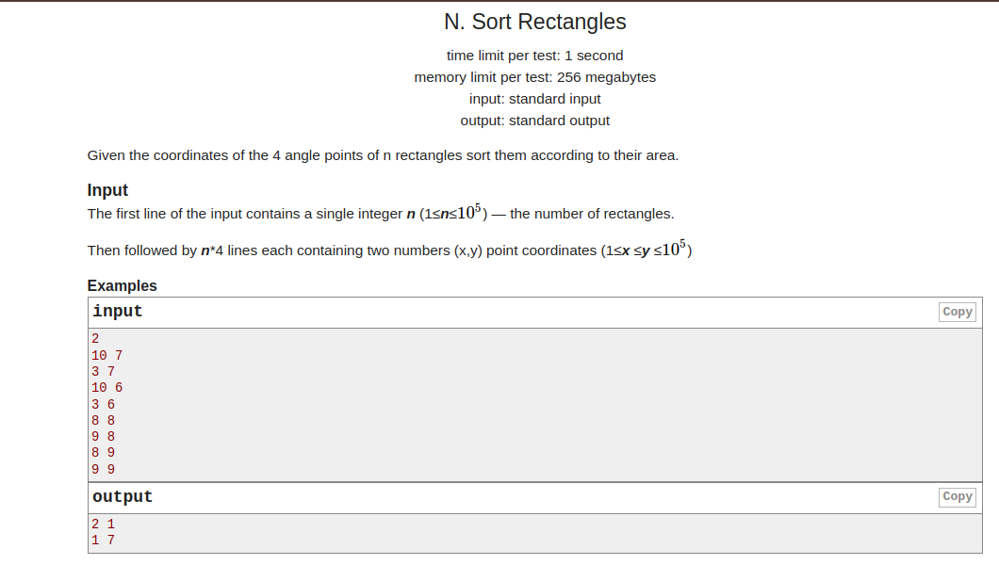
Statement
PROBLEM
LINK

Slide 18
solution

Slide 19
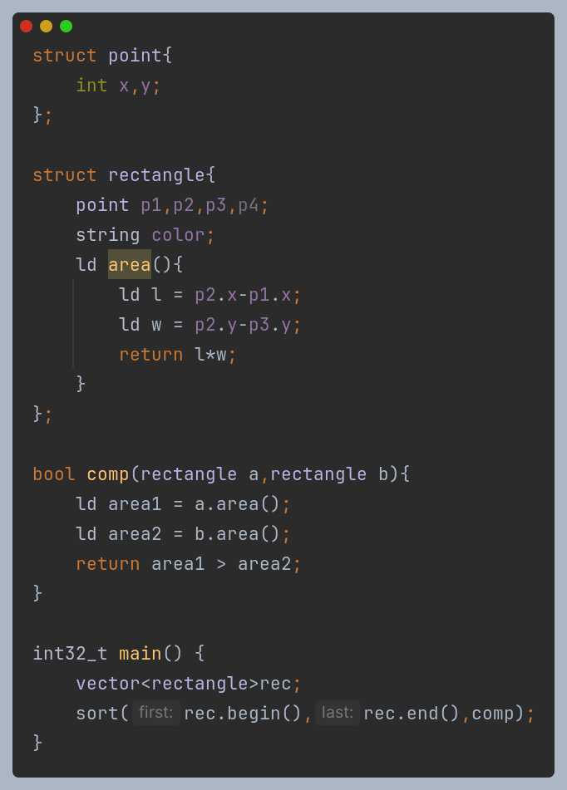
lv zero
Sort using compare function

Slide 20

lv zero
Wrong Answers

Slide 21

lv zero
Time limit exceeded

Slide 22


Break time

Slide 23
lv zero
Time Complexity
It Tells How fast an algorithm is
but I’ve got a faster processor than my ...

Slide 24


lv zero
Types of Time Complexity?
Omega
best case
Theta
Average case
Big O
Worst case

Slide 25





disscution

Slide 26
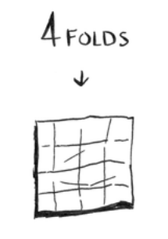
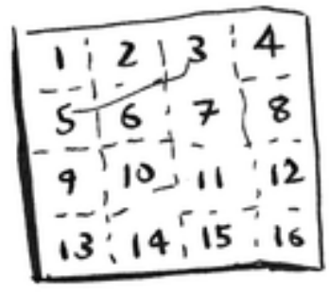
Linear time
Logarithmic time
Credits to: grokking algoritms book

Slide 27
Linear Time
Logarithmic Time
Polynomial running Time

Slide 28
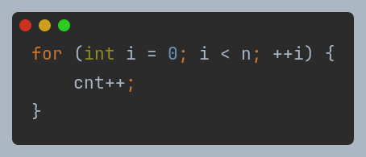
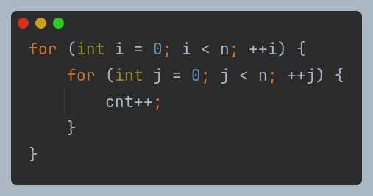
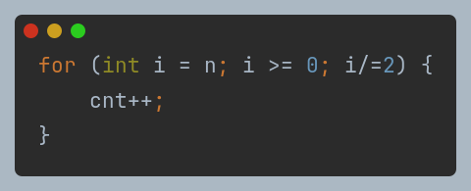
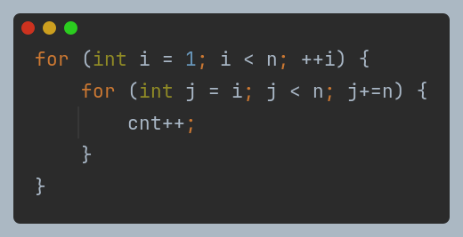
O(n)
O(n^2)
O(log2(n))
O(nlog(log(n)))

Slide 29
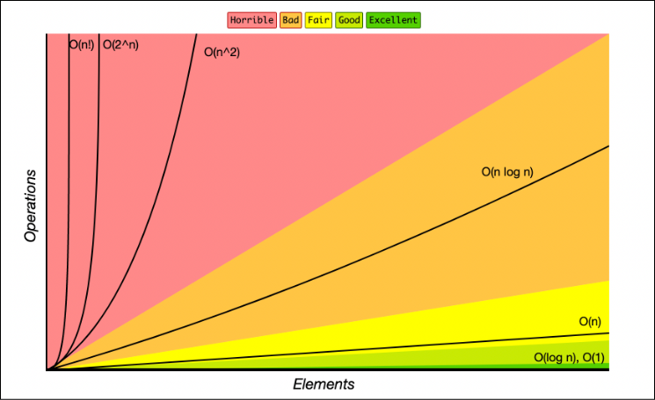

Slide 30
usually 10^8 steps takes 1 sec what about 2 sec?

Slide 31
coding time

Slide 32
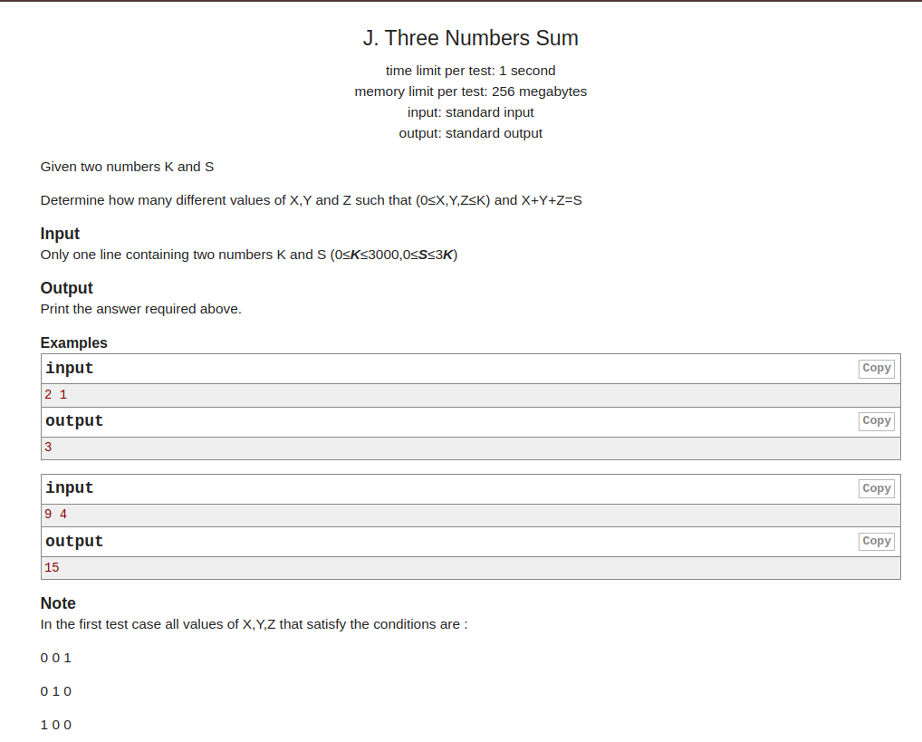
Statement
PROBLEM
LINK

Slide 33
solution

Slide 34
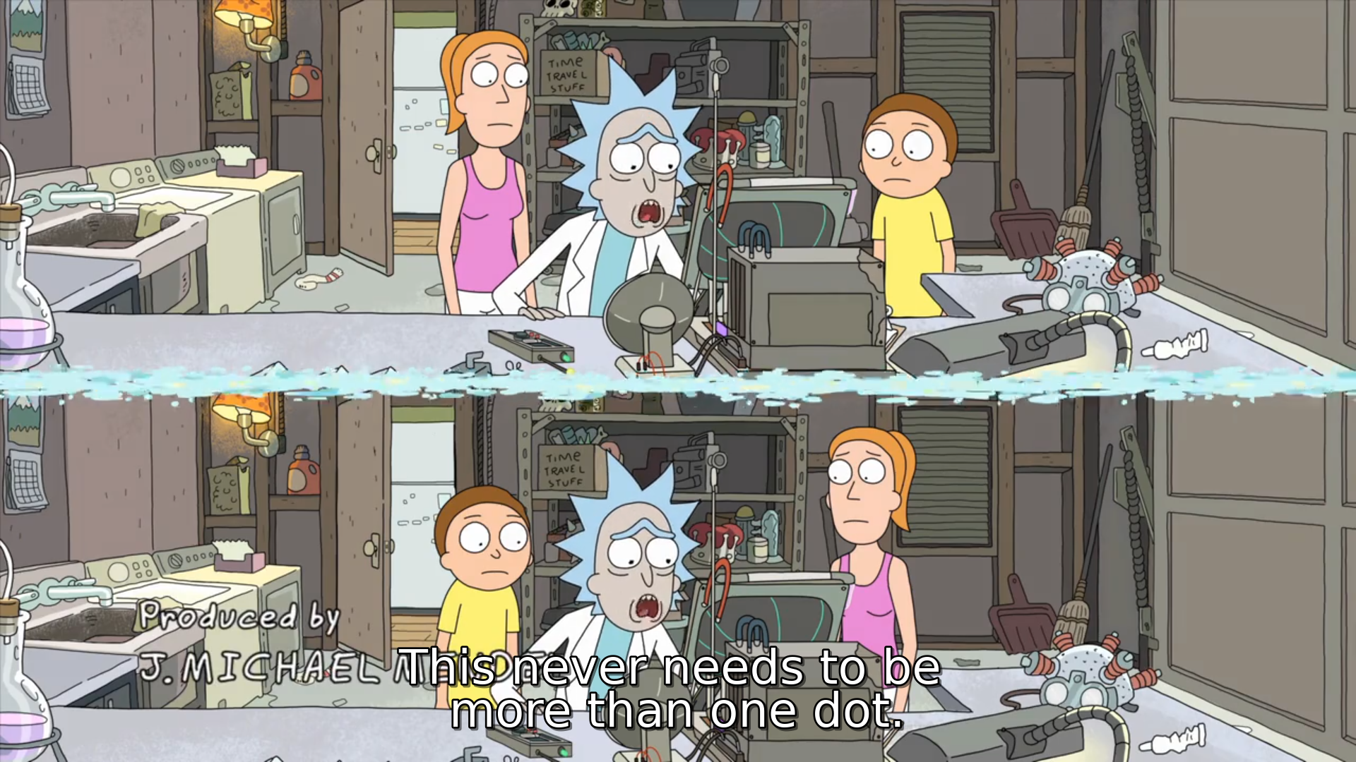
Loop

Slide 35
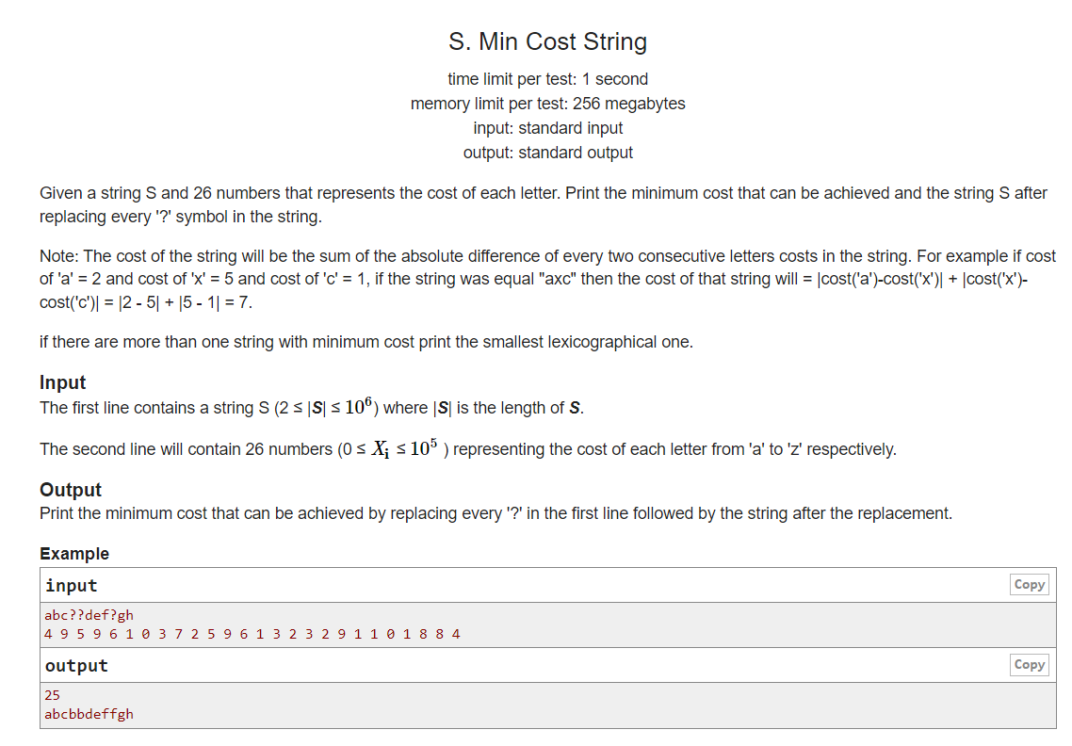
PROBLEM
LINK

Slide 36
solution

Slide 37

thank you

Slide 38






Slide 39






